Slide 1
The Industrial Backbone: A Comprehensive Insight into Sulfuric Acid
Production, Applications, and Industrial Significance

Slide 2
Overview
Definition:
Sulfuric acid is a highly corrosive, dense, oily liquid and a strong mineral acid, widely used in industrial and chemical processes. It is known for its ability to act as both a dehydrating and oxidizing agent.
Chemical Formula:
H₂SO₄
Metadata:
Appearance: Colorless to slightly yellow liquid
Molecular Weight: 98.079 g/mol
Density: 1.84 g/cm³
Melting Point: 10.31°C (50.56°F)
Boiling Point: 337°C (639°F)
Solubility: Highly soluble in water, releasing significant heat during dissolution
pH: Very low (acidic)
Common Names:
Oil of vitriol
Battery acid (in dilute form)

Slide 3

Exceptions In H2S04 Applications
Sulfuric acid is a widely used chemical in various industries, but here are some products where sulfuric acid is not typically used:
Baking products (e.g., bread, cakes, cookies)
Dairy products (e.g., milk, cheese, yogurt)
Fresh fruits and vegetables
Meat and poultry products
Most pharmaceuticals (although some may use sulfuric acid in the manufacturing process)
Cosmetics and personal care products (e.g., shampoo,
toothpaste, skincare)
Beverages (e.g., juice, soda, beer)
Wine and spirits
Most food additives (e.g., flavorings, colorings, preservatives)
Keep in mind that this is not an exhaustive list, and sulfuric acid might be used in some niche or specialized products.

Slide 4
Generations of contact process:
The contact process for producing sulfuric acid has undergone several generations of development, with each generation introducing improvements in catalysts, reactor designs, and process conditions. Here are the main generations of the contact process:
First Generation (1831-1880): This generation used platinum as the catalyst and was developed by Peregrine Phillips. The process was not very efficient and had high operating costs.
Second Generation (1880-1920): This generation introduced vanadium pentoxide (V2O5) as the catalyst, which was more efficient and cost-effective than platinum. The process was developed by Rudolf Messel.

Slide 5
Generations of contact process:
Third & Fourth Generation:
Third Generation (1920-1950): This generation saw the introduction of improved catalysts, such as vanadium phosphate, and more efficient reactor designs.
Fourth Generation (1950-1970): This generation introduced the use of cesium-promoted vanadium pentoxide catalysts, which further improved efficiency and reduced emissions.

Slide 6
Generations of contact process:
Fifth & Sixth Generation:
Fifth Generation (1970-1990): This generation saw the introduction of more advanced catalysts, such as potassium-promoted vanadium pentoxide, and improved reactor designs.
Sixth Generation (1990-present): This generation has focused on further improving efficiency, reducing emissions, and developing new catalysts. Modern contact process plants often use advanced technologies, such as computerized process control and waste heat recovery systems.

Slide 7
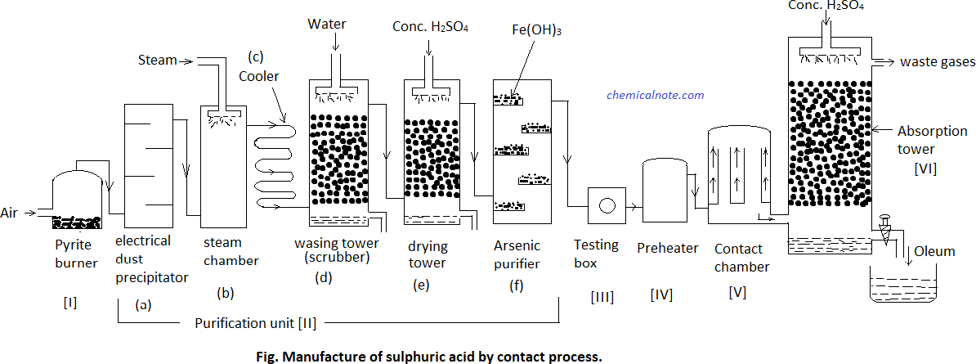
Contact Process Diagram
Labeled Diagram Of Contact Process

Slide 8
Does Pakistan use the method of contact process?
Yes, Pakistan uses the contact process method to produce sulfuric acid. The country has several sulfuric acid production plants, which use the contact process to manufacture sulfuric acid from sulfur.
Some of the major sulfuric acid production plants in Pakistan include:
PakArab Fertilizers Limited (PFL)
Engro Fertilizers Limited (EFL)
Fatima Fertilizer Company Limited (FFCL)
Fauji Fertilizer Company Limited (FFC)
These plants use the contact process to produce sulfuric acid, which is then used to manufacture fertilizers, such as urea and DAP.

Slide 9
Production of Sulphuric acid by contact process in different countries
Here's an overview of sulfuric acid production by the contact process in different countries:
China: China is the world's largest producer of sulfuric acid, with a production capacity of over 90 million tons per year. Most of China's sulfuric acid production uses the contact process.
United States: The US is the second-largest producer of sulfuric acid, with a production capacity of around 40 million tons per year. Major producers like DuPont, Monsanto, and Mosaic use the contact process.
India: India is also a significant producer of sulfuric acid, with a production capacity of over 20 million tons per year. Companies like Tata Chemicals, Grasim Industries, and Hindalco Industries use the contact process.

Slide 10
Production of Sulphuric acid by contact process in different countries
Pakistan: As I mentioned earlier, Pakistan also produces sulfuric acid using the contact process, with a production capacity of around 1.5 million tons per year.
Germany: Germany is a significant producer of sulfuric acid in Europe, with a production capacity of around 5 million tons per year. Companies like BASF, Bayer, and Evonik use the contact process.
Japan: Japan is also a significant producer of sulfuric acid, with a production capacity of around 3 million tons per year. Companies like Mitsubishi Chemical, Sumitomo Chemical, and Asahi Kasei use the contact process

Slide 11
Production of Sulphuric acid by contact process in different countries
South Korea: South Korea is another significant producer of sulfuric acid, with a production capacity of around 2 million tons per year. Companies like LG Chem, Samsung C&T, and Hyundai Chemical use the contact process.
These countries are followed by other major sulfuric acid- producing countries like Canada, Australia, and Brazil.

Slide 12
Thanks For Your Attention

